Slide 1



STUDENT INVOLVEMENT
at THE BEACH
Notes:
NEW Photo.
Opening introductions:
“Hello and welcome! My name is ____ ( ____ and I am the __(Position/Title)_____ for ____(Department)_____ here at the Beach. Today I’ll be sharing with you folks what kind of resources our department has to offer your students. As well as discuss how we can work together to ensure your student has the right support to be successful at here at the Beach.
During the presentation, if at any time you need to get up for any reason and take a break, please be sure to pause so that you do not miss any information! Our presentation will take roughly around 15- 20 minutes.
Write down any questions you have and save them for when we hold our live, online Parent & Family Orientation Zoom calls.
Before we get started, please have your pen and paper ready to take any notes!”

Slide 2
BENEFITS OF INVOLVEMENT
Stronger Academics
Increased Social Skills
Make Friends
Increased Self-Confidence
Sense of belonging/community
Obtain valuable skills valued by future employers
Create a network
Notes:
Benefits of Involved. TC

Slide 3
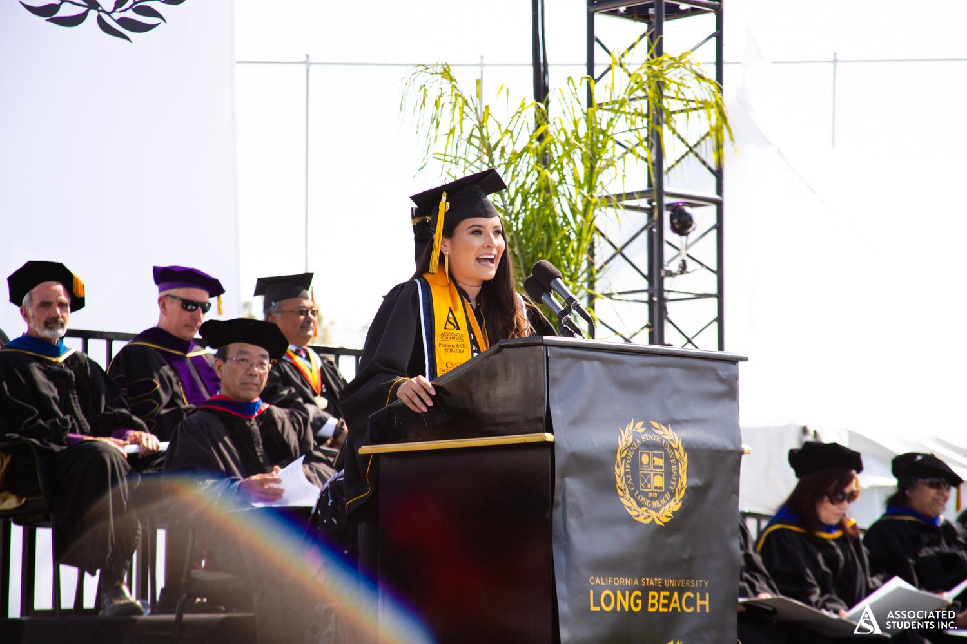
NATIONAL SURVEY OF STUDENT ENGAGEMENT, 2014
Students who become involved in co-curricular activities (clubs, student government, work on campus) at their college or university benefit in the following ways:
  Improvement in overall grade point average
  Shorter time to degree completion and on-track performance towards a degree
  Successful retention from one semester to the next
Notes:
TC. How involvement affects academics.

Slide 4
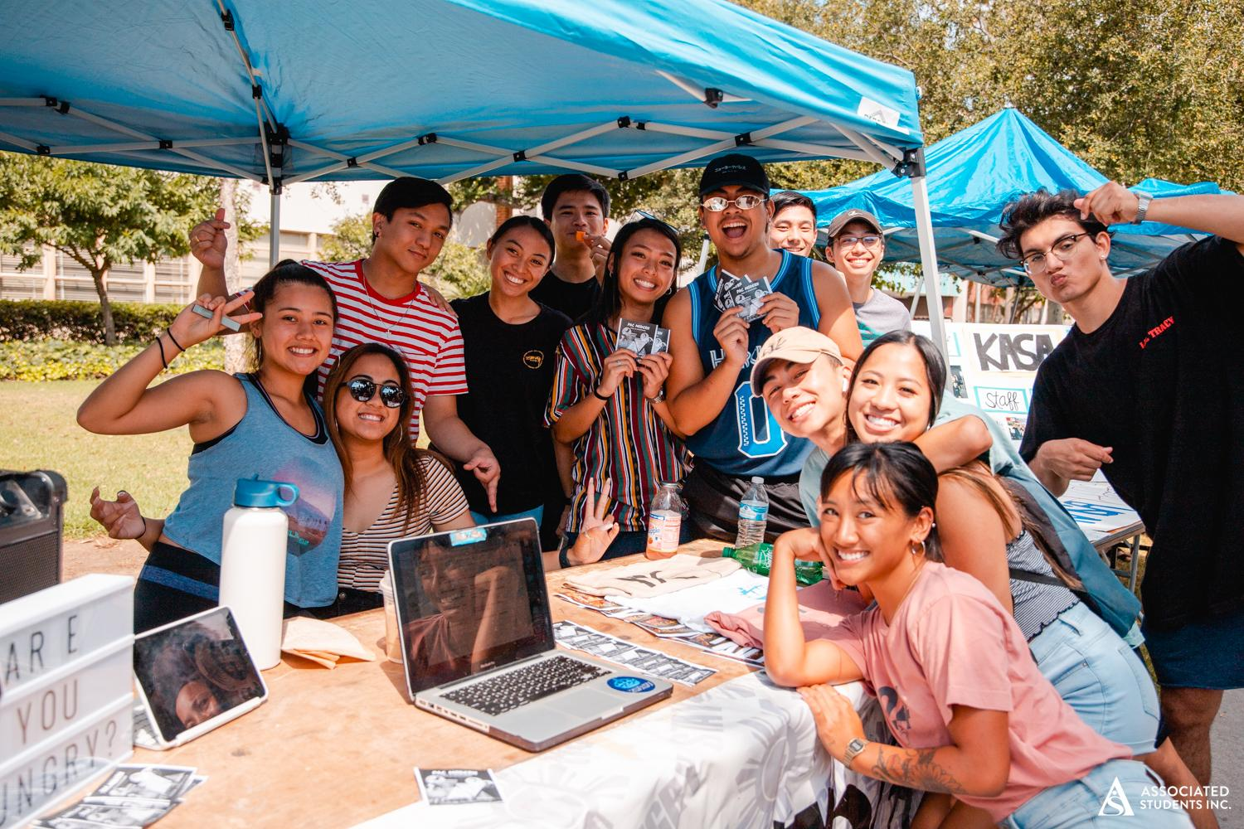
SKILLS EMPLOYERS VALUE
Leadership
Ability to Work in a Team Structure
Communication Skills
Problem Solving Skills
Strong Work Ethic and Initiative
Analytical/Quantitative Skills
Organizational Ability & Strategic Planning Skills
Interpersonal Skills
Flexibility & Adaptability
Initiative
Computer and Technical Skills
Job Outlook 2015, National Association of
Colleges and Employers
Notes:
TP. Work/Career Skills

Slide 5
WAYS TO GET INVOLVED
Student Clubs & Organizations
Fraternity & Sorority Life
Club Sports
Leadership Programs
Student Government
Community Service
On-Campus Employment
Attending Campus Events
Notes:
TP

Slide 6
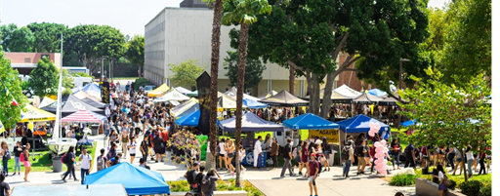
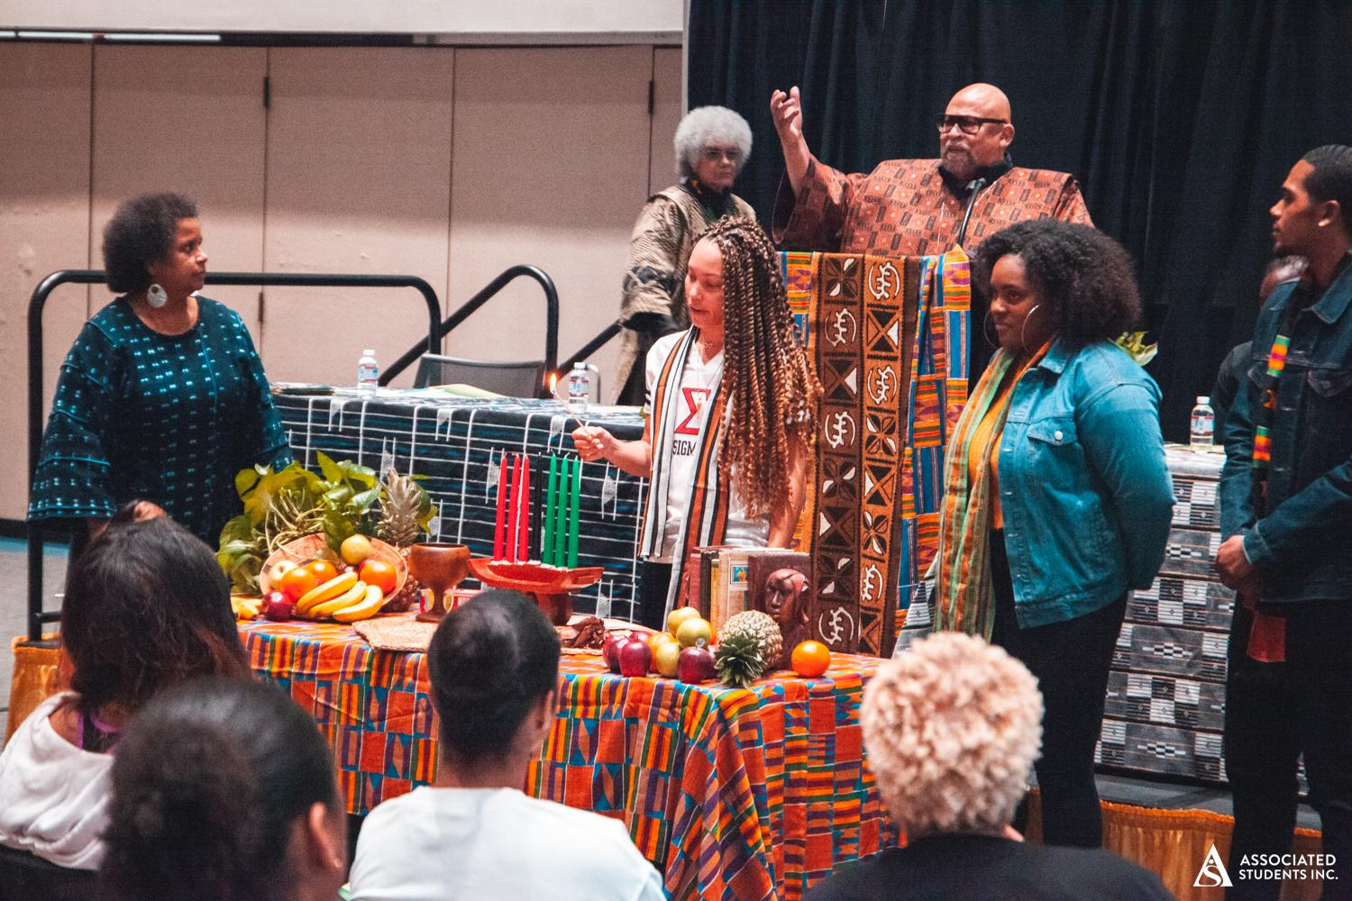
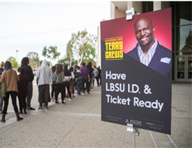

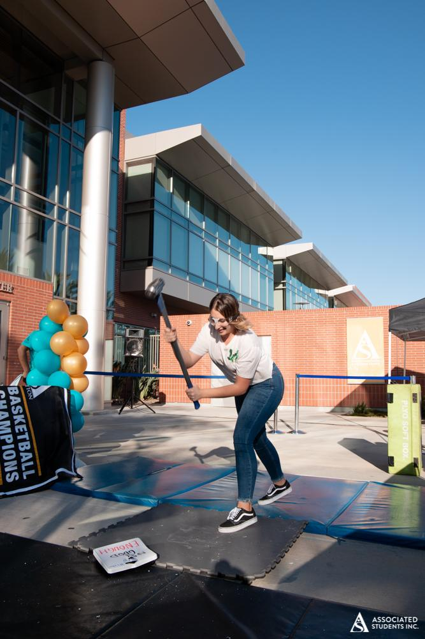
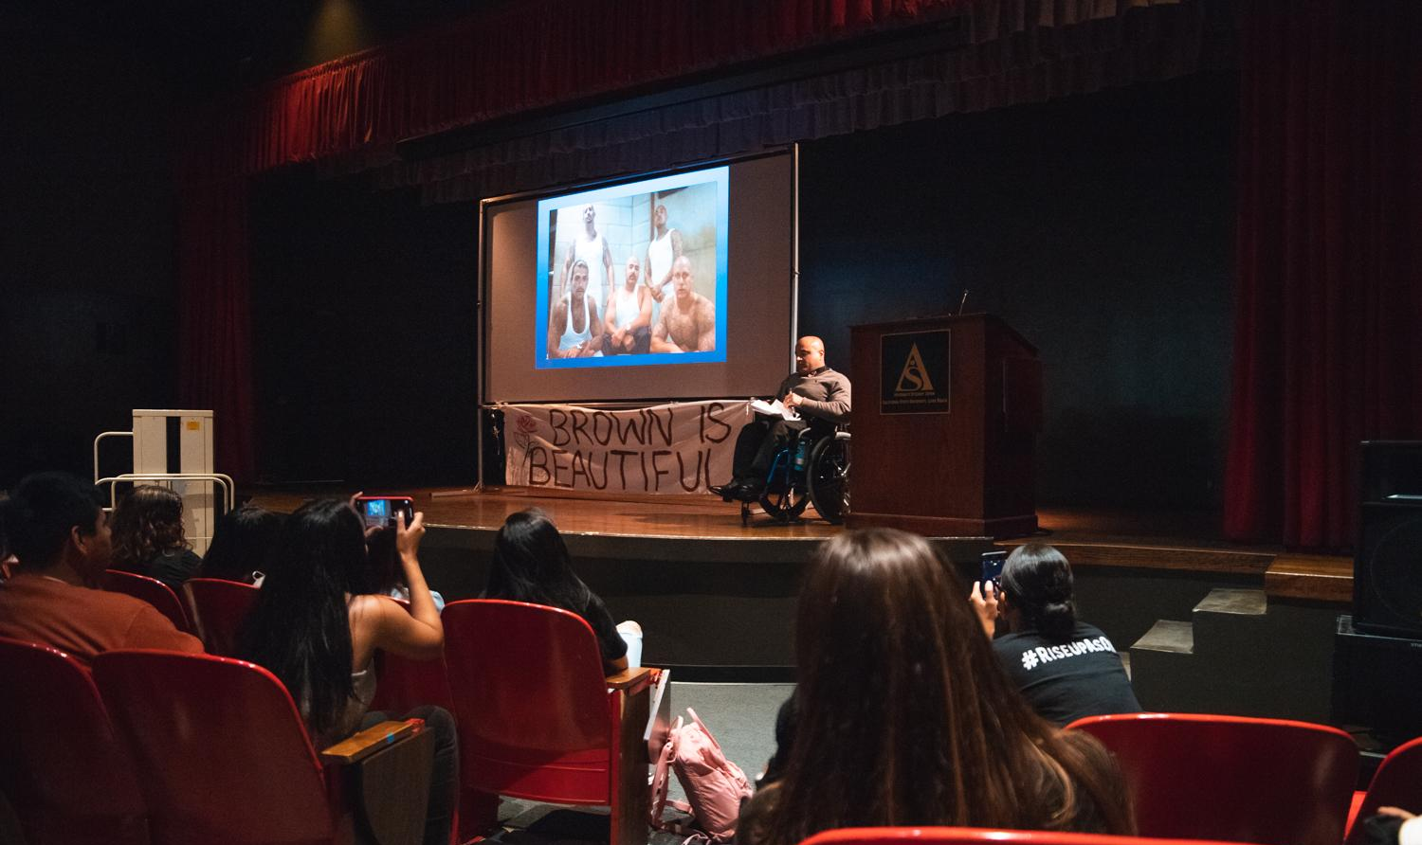
ENGAGING PROGRAMS
Not just leadership opportunities.
It can be important for family to encourage students to take part in the full college experience. This is where minds can open and they can make lifelong connections.
Annual Kwanzaa Celebration
Week of Welcome
Dr. Ken Jeong
Issues Minorities Face
Pop-Up
Love Your Body Week
Notes:
JA.

Slide 7
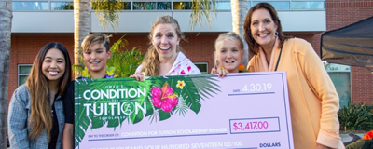
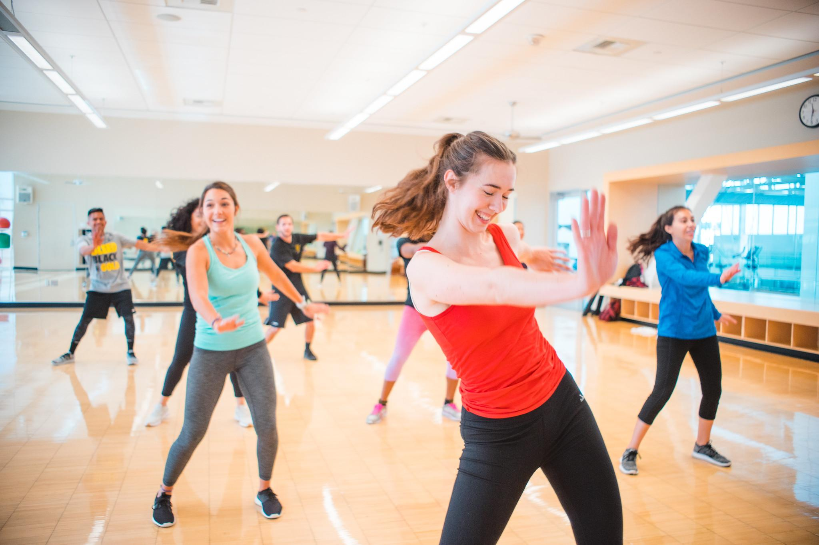
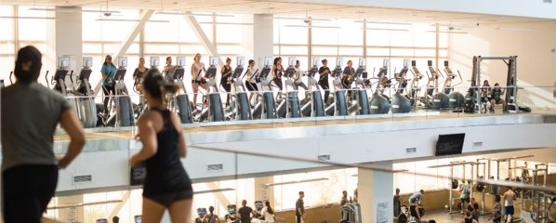
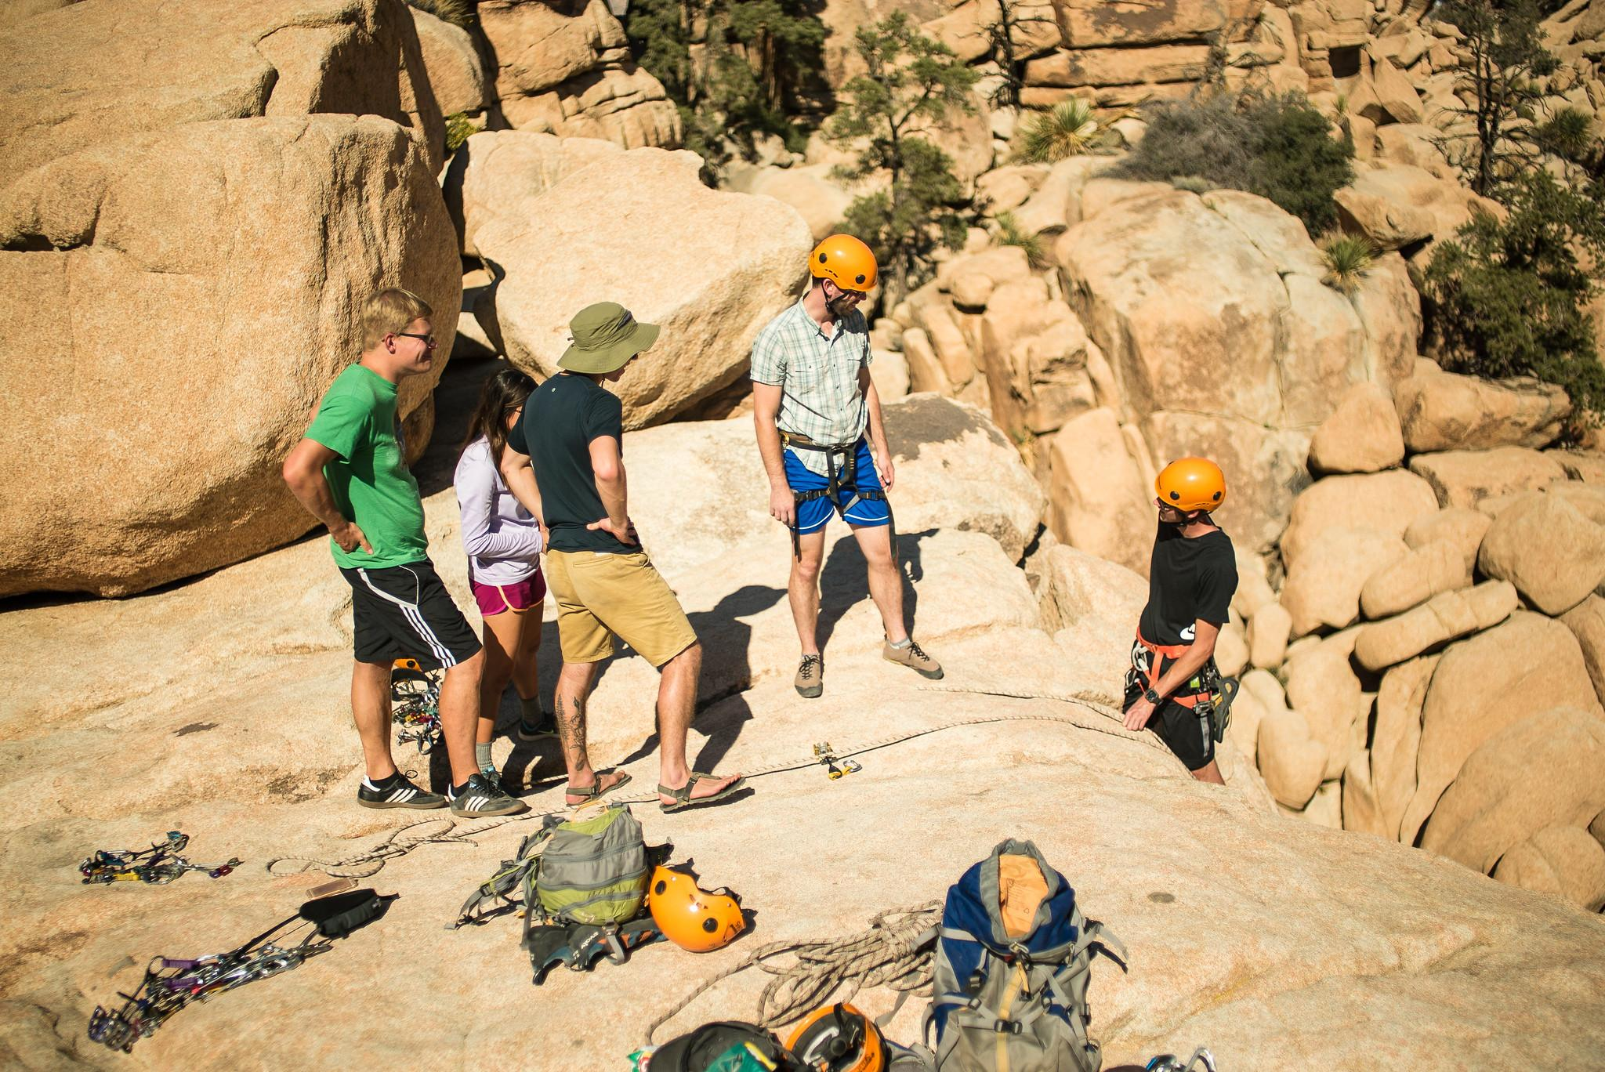
STUDENT REC & WELLNESS
126,500 sq. ft. facility
Open to all students
Personal training, massage therapy, indoor track, rock wall, racquetball courts, sand volleyball and so much more!
Making health & wellness a lifelong habit.
Win Tuition
Free Fitness Classes
Stay Well
Connect & Explore
Notes:
JA.

Slide 8
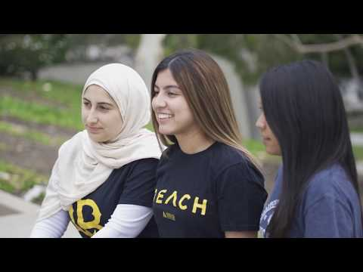
ASSOCIATED STUDENTS INC.
Notes:
JA. Intro and Play video.
Recap after, pass to Trace.

Slide 9

STUDENT LIFE & DEVELOPMENT
Fraternity
& Sorority Life
Club Sports
Student Organizations
Leadership
Programs
Notes:
Areas of Involvement that SLD Oversees

Slide 10


Student Life & Development
Notes:
This video will show you a glimpse of what student involvement looks like at CSULB. Student Life & Developtment (SLD) is the department that oversees the main areas of student inovlevment. ( Student Organizations, Fraternity and Sorority Life, Leadership Programs and Club Sports).

Slide 11
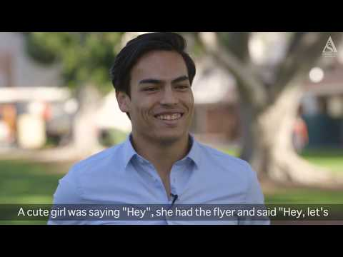
MAKING AN IMPACT
Notes:
JA.
Not playing video, just alluding to it and pointing to it.

Slide 12

BEACH SYNC PORTAL
Access beachsync.com to explore potential involvement opportunities!
Notes:
TP. Breaking Down Beach Sync.

Slide 13
SUCCESS IS
A TEAM EFFORT!
Family
Friends/Peers
Faculty
Staff
Community
Notes:
TP. Why student success is a collaborative effort.

Slide 14
FAQs
What does that average day of a CSULB student look like?
How can I support my student to be more involved?
Does it cost any money to join these involvement opportunities?
How can my student balance school and extracurricular activities?
What is the best area for my student to be involved with?
What is a fraternity & sorority?
How can one join a student organization?
What is the difference between a club sport and college athletics?
Notes:
TP. FAQS.

Slide 15

Thank You!
All presentation info available at: www.asicsulb.org/pfo
STUDENT LIFE & DEVELOPMENT
Office: University Student Union, Room 215 (USU-215)
Phone: (562) 985-4181
Email: SS-StudentLife@csulb.edu
Fall/Spring Academic Hours
Monday - Friday: 8:00 AM - 5:00 PM
Tuesday: 8:00 AM - 7:00 PM Extended Hours
ASSOCIATED STUDENTS, INC.
Office: University Student Union, Room 311 (USU-311)
Events: www.asicsulb.org/events
Jobs: www.asicsulb.org/work
Volunteer: asicsulb.org/volunteer
Social Media: @CSULBASI
Notes:
Contact Information

Slide 16

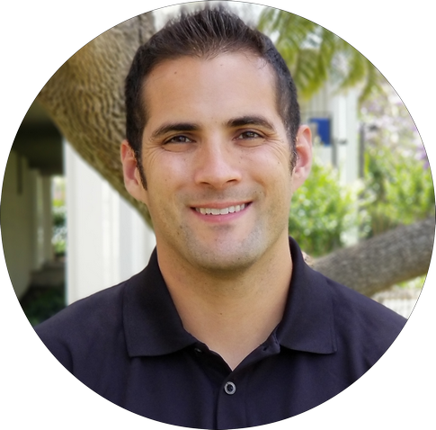
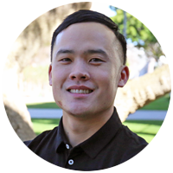
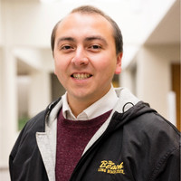
Presenter Contact Info
Dr. Trace Camacho
Director, Student Life & Development
Trace.Camacho@csulb.edu
Timothy Pham
Coordinator, Student Life & Development
Timothy.Pham@csulb.edu
James Ahumada
Sr. Comms Manager,
Associated Students, Inc.
James.Ahumada@csulb.edu

